Slide 1

Abstractive Linguistic Summarization with Keras
Ruba Almahasneh
Prof Bálint GYIRES-TÓTH

Slide 2
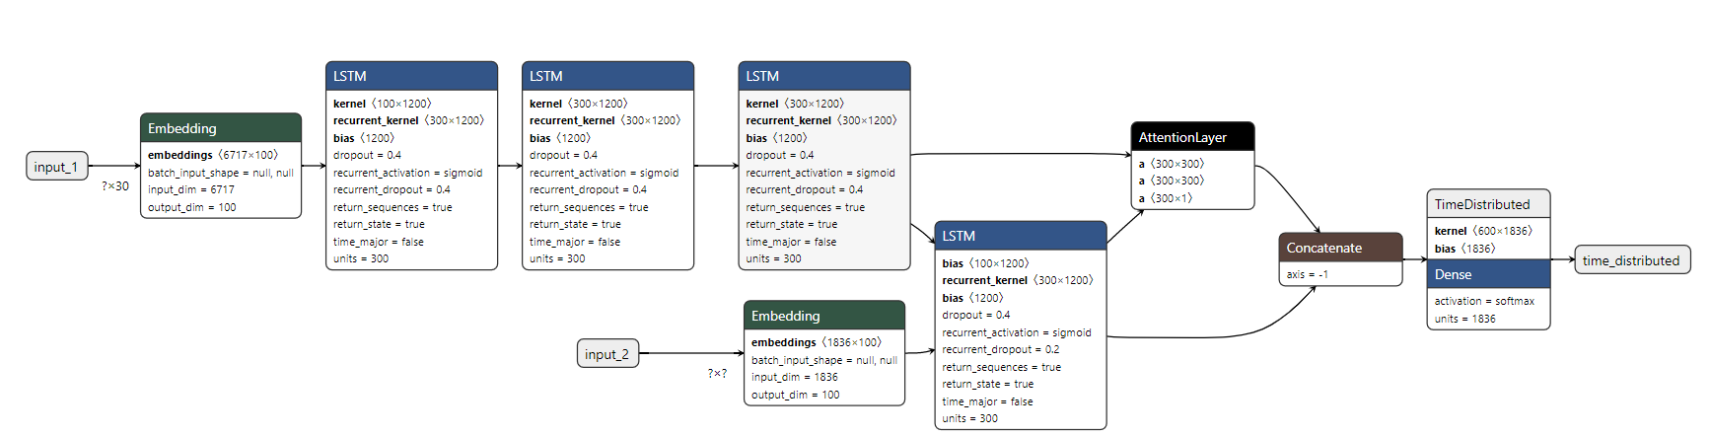
Model

Slide 3
Model Building
Cleaning (lowercase, remove HTML tags, remove (‘s),parenthesis ( ),Eliminate punctuations and special characters, remove stop words, short words)
Removing anomalies (remove short sentences, Long sentences)
Tokenization (Text Tokenizer + Summary Tokenizer: dividing the text into a set of meaningful pieces (tokens)
Word index
Sequences
Padding sequences
Stemming and lemmatization
Embedding
LSTM –RNN different architectures tried out
Recursive Model
Attention Mechanism
TimeDistributed
Dense
Softmax

Slide 4
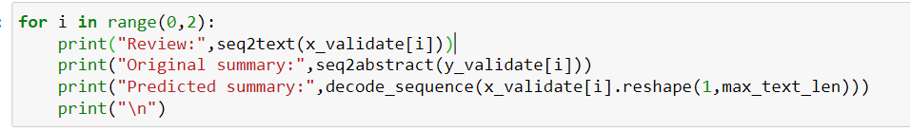
Prediction
Review: simply bar simply fantastic love vegan high protein helpful need find alternative protein sources also provide amazing flavors favorite peanut butter one
Original summary: simply awesome
Predicted summary: delicious
Review: longer find flavored tea stores amazon place get thanks amazon
Original summary: raspberry tea
Predicted summary: great tea

Slide 5
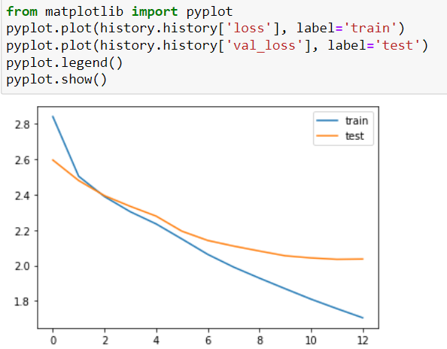
Evaluation and Enhancement
After many iterations the best results I have achieved were in the diagram below, with 12 epochs,128 batch size, adam optimizer, with drop out 0.4 and early stopping mechanism. training Val_loss around 2.1
I have used ROUGE: recall-based evaluation, BLEU: precision-based evaluation metric for evaluation
Possible enhancements :
Beam search is a good way to enhance the model
GLOVE Embedding
C-RNN-GAN
Hyper-parameter optimization and Gaussian Process

Slide 6
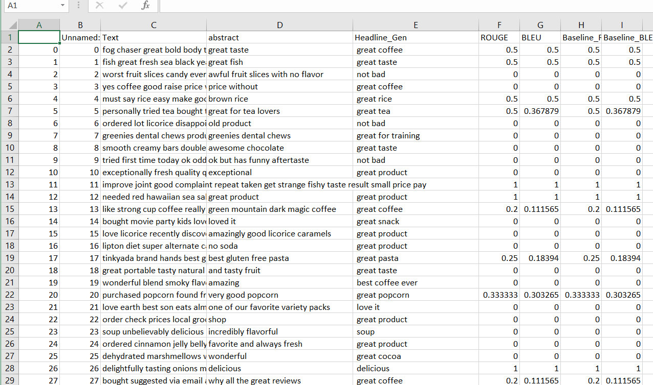
RougE + BLEU

